Slide 1


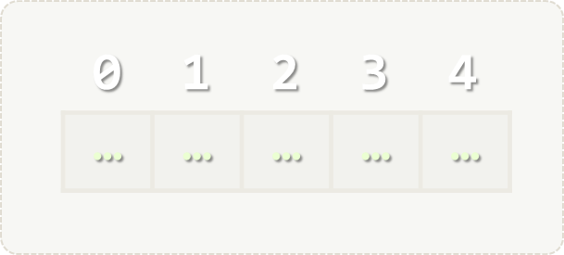

Arrays
Processing Arrays: Fixed-Size Sequences of Elements
Programming Fundamentals
SoftUni Team
Technical Trainers
Software University
http://softuni.bg

Slide 2
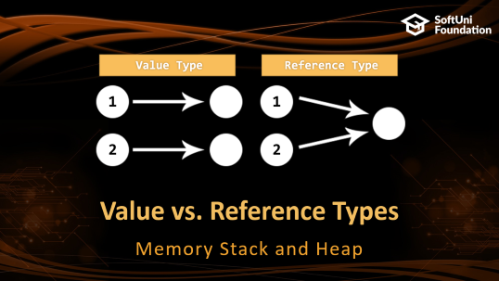
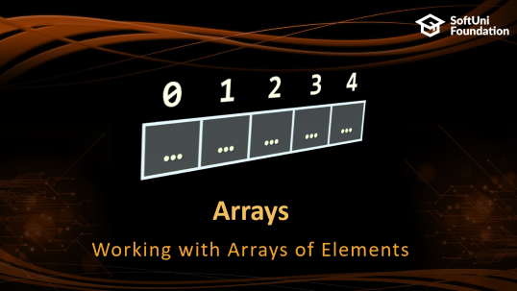
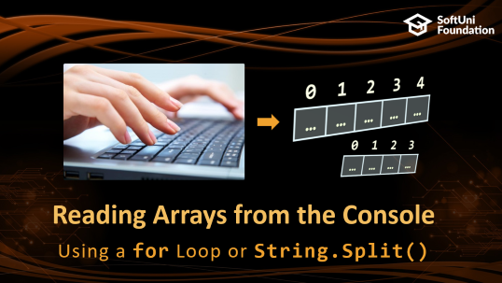
Table of Contents

Slide 3
Have a Question?
sli.do #fund-softuni

Slide 4
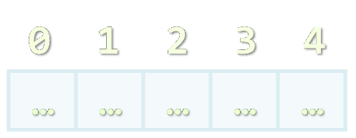
Arrays
Working with Arrays of Elements

Slide 5
What are Arrays?
In programming, an array is a sequence of elements
Elements are numbered from 0 to Length-1
Elements are of the same type (e.g. integers)
Arrays have fixed size (Array.Length) – cannot be resized
0 1 2 3 4
Element index
Array of 5 elements
… | … | … | … | …
Element of an array

Slide 6
Working with Arrays
All elements are initially == 0
Allocating an array of 10 integers:
Assigning values to the array elements:
Accessing array elements by index:
int[] numbers = new int[10];
The Length holds the number of array elements
for (int i = 0; i < numbers.Length; i++)
numbers[i] = 1;
The [] operator accesses elements by index
numbers[5] = numbers[2] + numbers[7];
numbers[10] = 1; // IndexOutOfRangeException

Slide 7
Days of Week – Example
The days of week can be stored in array of strings:
string[] days = {
"Monday",
"Tuesday",
"Wednesday",
"Thursday",
"Friday",
"Saturday",
"Sunday"
};
Expression | Value
days[0] | Monday
days[1] | Tuesday
days[2] | Wednesday
days[3] | Thursday
days[4] | Friday
days[5] | Saturday
days[6] | Sunday

Slide 8
Problem: Day of Week
Enter a day number [1…7] and print the day name (in English) or "Invalid day!"
Check your solution here: https://judge.softuni.bg/Contests/Practice/Index/172#0

Slide 9
Solution: Day of Week
string[] days = { "Monday", "Tuesday", "Wednesday", "Thursday", "Friday", "Saturday", "Sunday" };
int day = int.Parse(Console.ReadLine());
if (day >= 1 && day <= 7)
Console.WriteLine(days[day - 1]);
else
Console.WriteLine("Invalid day!");
Check your solution here: https://judge.softuni.bg/Contests/Practice/Index/172#0

Slide 10
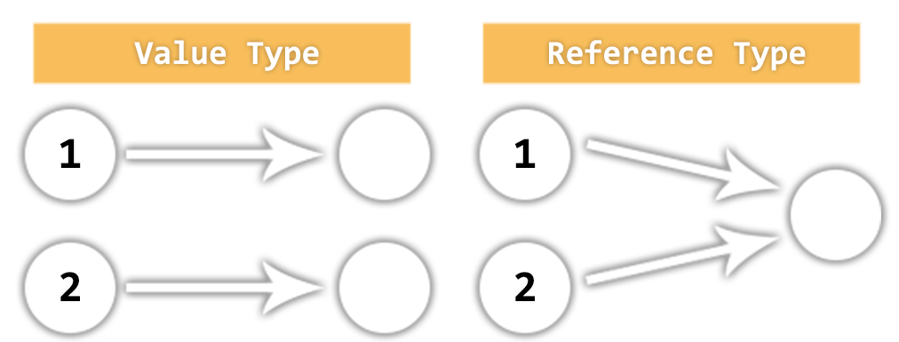
Value vs. Reference Types
Memory Stack and Heap

Slide 11
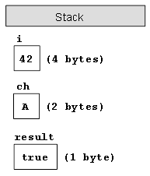
Value Types
Value type variables hold directly their data
int, float, double, bool, char, DateTime, BigInteger, …
msdn.microsoft.com/library/bfft1t3c.aspx
Each variable has its own copy of the data
int i = 42;
char ch = 'A';
bool result = true;

Slide 12
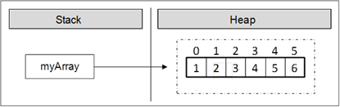
Reference Types
Reference type variables hold reference (pointer / memory address) of the data itself
string, int[], char[], string[], Random, instances of classes, interfaces, delegates
Two reference type variables can reference the same object
Operations on both variables access / modify the same data
var arr = new int[] {
1, 2, 3, 4, 5, 6 };

Slide 13
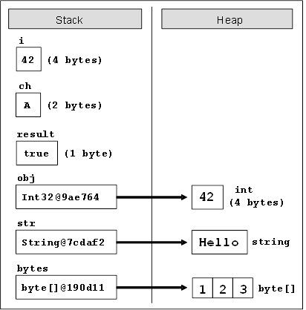
Value Types vs. Reference Types
int i = 42;
char ch = 'A';
bool result = true;
object obj = 42;
string str =
"Hello";
byte[] bytes =
{ 1, 2, 3 };

Slide 14
Value vs. Reference Types

Slide 15
Example: Value Types
public static void Main()
{
int num = 5;
Increment(num, 15);
Console.WriteLine(num);
}
private static void Increment(int num, int value)
{
num += value;
}
num == 5
num == 20

Slide 16
Example: Reference Types
public static void Main()
{
int[] nums = { 5 };
Increment(nums, 15);
Console.WriteLine(nums[0]);
}
private static void Increment(int[] nums, int value)
{
nums[0] += value;
}
num == 20
num == 20

Slide 17

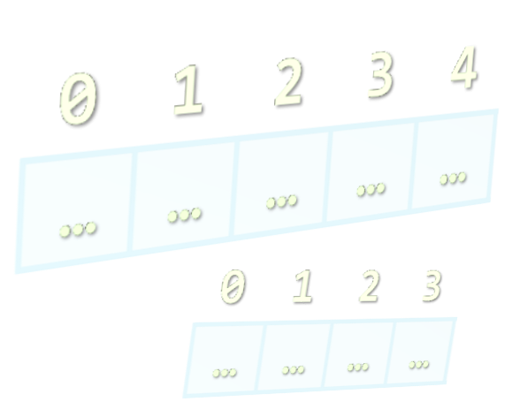
Reading Arrays from the Console
Using a for Loop or String.Split()

Slide 18
Reading Arrays From the Console
First, read from the console the array length:
Next, create an array of given size n and read its elements:
int n = int.Parse(Console.ReadLine());
int[] arr = new int[n];
for (int i = 0; i < n; i++)
{
arr[i] = int.Parse(Console.ReadLine());
}

Slide 19
Reading Array Values from a Single Line
Arrays can be read from a single line of space separated values:
2 8 30 25 40 72 -2 44 56
.Split(' ') splits by space into string[]
string values = Console.ReadLine();
string[] items = values.Split(' ');
int[] arr = new int[items.Length];
for (int i = 0; i < items.Length; i++)
arr[i] = int.Parse(items[i]);

Slide 20
Shorter: Reading Array from a Single Line
Read an arrays of integers using functional programming:
Or event shorter:
2 8 30 25 40 72 -2 44 56
using System.Linq;
…
var inputLine = Console.ReadLine();
string[] items = inputLine.Split(' ');
int[] arr = items.Select(int.Parse).ToArray();
int[] arr = Console.ReadLine().
Split(' ').Select(int.Parse).ToArray();

Slide 21
Printing Arrays on the Console
To print all array elements, a for-loop can be used
Separate elements with white space or a new line
Example:
string[] arr = {"one", "two", "three", "four", "five"};
// Process all array elements
for (int index = 0; index < arr.Length; index++)
{
// Print each element on a separate line
Console.WriteLine("arr[{0}] = {1}", index, arr[index]);
}

Slide 22
Problem: Reverse an Array of Integers
Read an array of integers (a number n + n lines of integers), reverse it and print its elements (on a single line, space-separated):
3
10
20
30
30 20 10
4
-1
20
99
5
5 99 20 -1
Check your solution here: https://judge.softuni.bg/Contests/Practice/Index/172#1

Slide 23
Solution: Reverse an Array of Integers
// Read the array (a number n + n lines of integers)
var n = int.Parse(Console.ReadLine());
var arr = new int[n];
for (int i = 0; i < n; i++)
arr[i] = int.Parse(Console.ReadLine());
// Print the elements from the last to the first
for (int i = n-1; i >= 0; i--)
Console.Write(arr[i] + " ");
Console.WriteLine();
Check your solution here: https://judge.softuni.bg/Contests/Practice/Index/172#1

Slide 24
Problem: Rounding Numbers
Read an array of real numbers (space separated values), round them in "away from 0" style and print the output as in the examples:
0.9 1.5 2.4 2.5 3.14
-5.01 -1.599 -2.5 -1.50 0
0.9 => 1
1.5 => 2
2.4 => 2
2.5 => 3
3.14 => 3
-5.01 => -5
-1.599 => -2
-2.5 => -3
-1.50 => -2
0 => 0
Check your solution here: https://judge.softuni.bg/Contests/Practice/Index/172#4

Slide 25

Solution: Rounding Numbers
Rounding turns each value to the nearest integer
double[] nums = ReadNumbers();
int[] roundedNums = new int[nums.Length];
for (int i = 0; i < nums.Length; i++)
roundedNums[i] = (int) Math.Round(nums[i],
MidpointRounding.AwayFromZero);
for (int i = 0; i < nums.Length; i++)
Console.WriteLine($"{nums[i]} -> {roundedNums[i]}");
Check your solution here: https://judge.softuni.bg/Contests/Practice/Index/172#4

Slide 26
Printing Arrays with foreach / String.Join(…)
Use foreach-loop:
Use string.Join(separator, array):
int[] arr = { 10, 20, 30, 40, 50};
foreach (var element in arr)
Console.WriteLine(element)
int[] arr = { 1, 2, 3 };
Console.WriteLine(string.Join(", ", arr)); // 1, 2, 3
string[] strings = { "one", "two", "three", "four" };
Console.WriteLine(string.Join(" - ", strings)); // one - two - three - four

Slide 27
Problem: Reverse Array of Strings
Read an array of strings (space separated values), reverse it and print its elements:
Reversing array elements:
a b c d e
e d c b a
-1 hi ho w
w ho hi -1
exchange
a
b
c
d
e
Check your solution here: https://judge.softuni.bg/Contests/Practice/Index/172#5

Slide 28
Solution: Reverse Array of Strings
var nums = Console.ReadLine().Split(' ').ToArray();
for (int i = 0; i < nums.Length / 2; i++)
SwapElements(nums, i, nums.Length - 1 - i);
Console.WriteLine(string.Join(" ", nums));
static void SwapElements(string[] arr, int i, int j)
{
var oldElement = arr[i];
arr[i] = arr[j];
arr[j] = oldElement;
}
Check your solution here: https://judge.softuni.bg/Contests/Practice/Index/172#5

Slide 29

Arrays – Exercises
Live Exercises in Class (Lab)

Slide 30

Summary
Arrays hold a sequence of elements
Elements are numbered from 0 to length-1
Creating (allocating) an array:
Accessing array elements by index:
Printing array elements:
int[] numbers = new int[10];
int[] nums = new int[] { 1, 2, 3 };
numbers[5] = 10;
Console.Write(string.Join(" ", arr));

Slide 31







Programming Fundamentals – Arrays
https://softuni.bg/courses/programming-fundamentals

Slide 32
License
This course (slides, examples, demos, videos, homework, etc.) is licensed under the "Creative Commons Attribution-NonCommercial-ShareAlike 4.0 International" license

Slide 33





Trainings @ Software University (SoftUni)
Software University – High-Quality Education, Profession and Job for Software Developers
softuni.bg
Software University Foundation
http://softuni.foundation/
Software University @ Facebook
facebook.com/SoftwareUniversity
Software University Forums
forum.softuni.bg

